Slide 1
ΑCHILLEAS G. CHALDAEAKES
Professor, NKUA
Byzantine Music Instruction
Thoughts & Suggestions

Slide 2
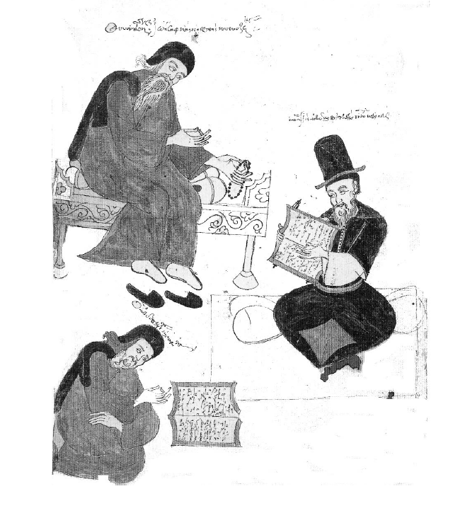

Slide 3
“By […] means of the phonetic and non-phonetic signs Psaltic Art creates theseis, which have the same relationship in Psaltic Art as words do in grammar. And gesturing distinguishes and considers these as good or not, as the case may be".
Gabriel, p. 72³⁷⁷⁻³⁸⁰

Slide 4
"... just like with letters omega and omicron are the same in pronunciation, but differ in that one is short but the other long. Similarly ita and iota and upsilon and other dipthongs are the same to speak but each is different as to length shortness and in their other values, it is the same with signs which have but one voice, that in measure they are the same, but are different in another way. Because the Oligon and the Oxeia are gestured differently, as are the Petasthi and the two Kentimata...” […] "and because we do not only use the twenty four letters but we also need the ten prosodies for speech to be euphonic, similarly not only the fifteen phonetic signs but the other thirty six non-phonetic ones are also useful, which, in Psaltic Art, are related to the prosodies. Because these are like a guide or governor of the manner or manner of saying, whether to deploy the voices slowly or shortly, or whether with tone or quietly. Because the voices are created […] by the phonetic signs, and the stops and shortnesses and the other values of these parts by the grand signs”] .
Gabriel, pp. 48⁹⁷⁻¹⁰⁶, 60²⁴¹⁻²⁵⁰

Slide 5
“Time and the modes of generating the notes are the elements that can explain the quality of chant. When the notes represented by neumes are not linked with time-indications, they resemble the syllables of the grammaticians, which make no sense unless employed in words. So, time is what links the notes together bringing them to the status of words”
Chrysanthos, Great Theory of Music, p. 75^{§113}

Slide 6
“Thesis means the union of signs which form the melody. As in grammar the union of the twenty-four letters forms words in syllables, in the same way the signs of the sounds are united scientifically and form the melody. This then is called thesis”.
Chrysaphes, pp. 40-41⁹¹⁻⁹⁶

Slide 7
“and these theseis have been noted by us and by others, in order that beginners can start their preliminary exercises piecemeal, then learn and chant them and then move forward”.
Erotapokriseis, p. 60³⁹²⁻³⁹⁵
”Such methods were written by other teachers musicians also, by which they introduce their students in music for their evolution“.
Chrysanthos, Great Theory of Music, p. 240^{§65}

Slide 8
“…Parallage was to adapt the polysyllable notes on the neumes of the melody’s quantity, written, and to chant their continuous ascent and descent, and never the ison or large intervals. Metrophonia was to chant the melody of the troparion, as indicated by the neumes that notate the quantity of melody only, without observing the indications of the hypostaseis and the theses. Melos was to chant the melos of the troparion as indicated by the theses of the neumes and the hypostaseis, by which is written not only the quantity of the melody but also the quality, without ignoring the words of the text…”.
Chrysanthos, Great Theory of Music, pp. 241-243^{§§69-73}

Slide 9
“Thus, the science of chanting does not consist only of parallage […] but includes many other methods […] The practice of parallage in chanting is the least significant of all techniques, and the easiest”.
Chrysaphes, pp. 38-39⁵²⁻⁵⁶

Slide 10
“And up to the time when the musical creations were few, the students learned them easily and in a short time by tradition. When however in the course of time the creations of the teachers increased in number, then teaching the students and learning the ecclesiastical songs required the analogous longer time”.
Chrysanthos, Great Theory of Music, p. 241^{§68}

Slide 11
“in order that a beginner chants […] correctly, he must be taught by a Greek musician, because the musician of a different nation pronounces the notes differently, due to his native language’s pronunciation patterns, and is not using the intervals of the tonoi as we do”.
Chrysanthos, Great Theory of Music, p. 38^{§19}

Slide 12
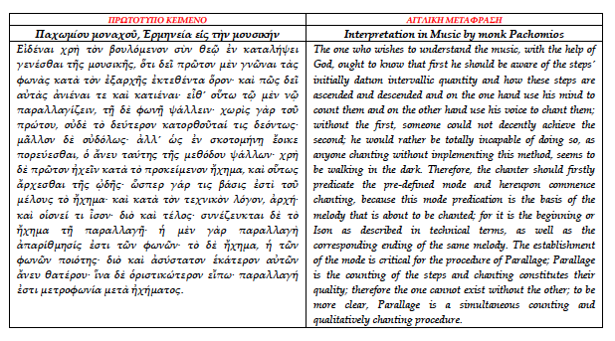

Slide 13
The one who wishes to understand the music ought to know that first he should be aware of the steps’ initially datum intervallic quantity and how these steps are ascended and descended and on the one hand use his mind to count them and on the other hand use his voice to chant them; without the first, someone could not decently achieve the second;
The establishment of the mode is critical for the procedure of Parallage; Parallage is the counting of the steps and chanting constitutes their quality; therefore the one cannot exist without the other; to be more clear, Parallage is a simultaneous counting and qualitatively chanting procedure.

Slide 14
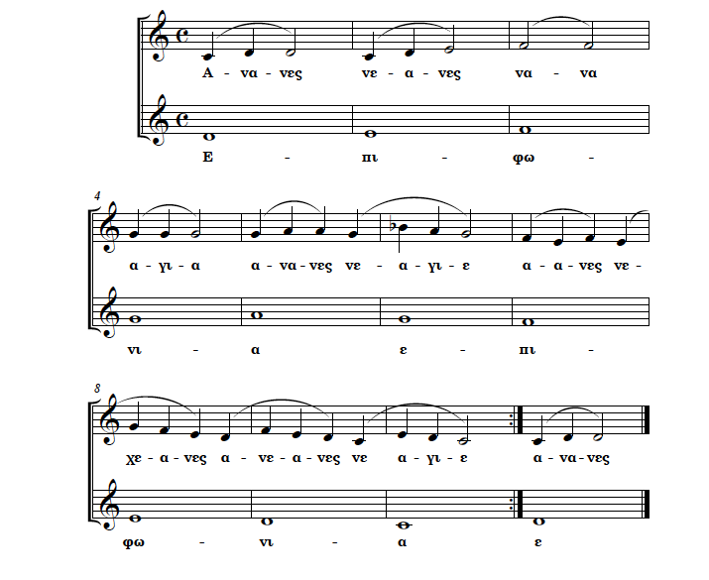
parallage is the counting of the steps and chanting constitutes their quality; therefore the one cannot exist without the other;

Slide 15
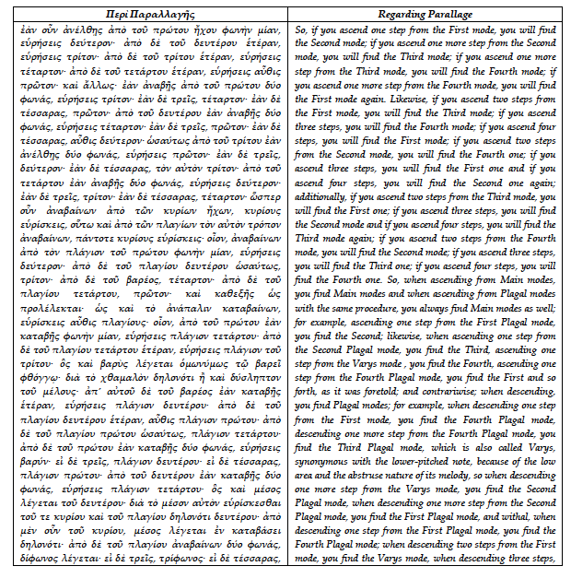

Slide 16
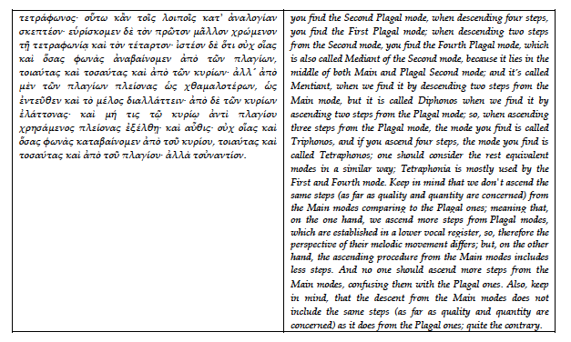

Slide 17
if you ascend one step from the First mode, you will find the Second mode; if you ascend one more step from the Second mode, you will find the Third mode; if you ascend one more step from the Third mode, you will find the Fourth mode; if you ascend one more step from the Fourth mode, you will find the First mode again. AND
descending one step from the First mode, you find the Fourth Plagal mode, descending one more step from the Fourth Plagal mode, you find the Third Plagal mode […] descending one more step from the Varys mode, you find the Second Plagal mode […] descending one more step from the Second Plagal mode, you find the First Plagal mode, and withal, when descending one step from the First Plagal mode, you find the Fourth Plagal mode;

Slide 18
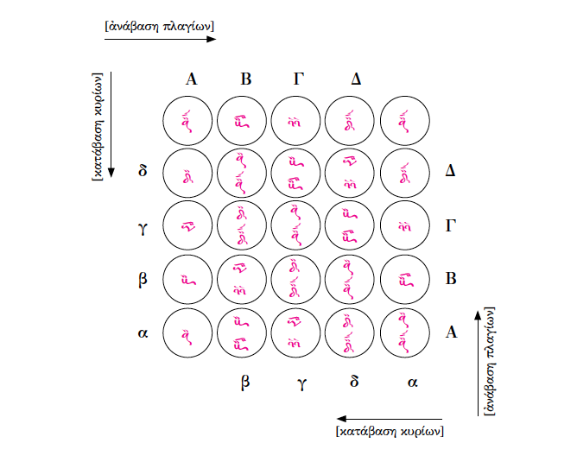
if you ascend one step from the First mode, you will find the Second mode; if you ascend one more step from the Second mode, you will find the Third mode; if you ascend one more step from the Third mode, you will find the Fourth mode; if you ascend one more step from the Fourth mode, you will find the First mode again

Slide 19
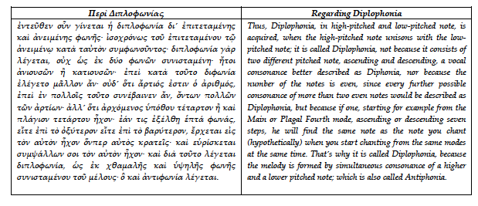

Slide 20
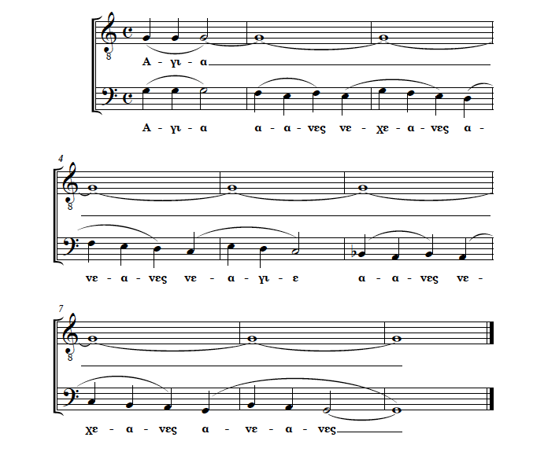
starting for example from the Main or Plagal Fourth mode, ascending or descending seven steps, he will find the same note as the note you chant (hypothetically) when you start chanting from the same modes at the same time.

Slide 21
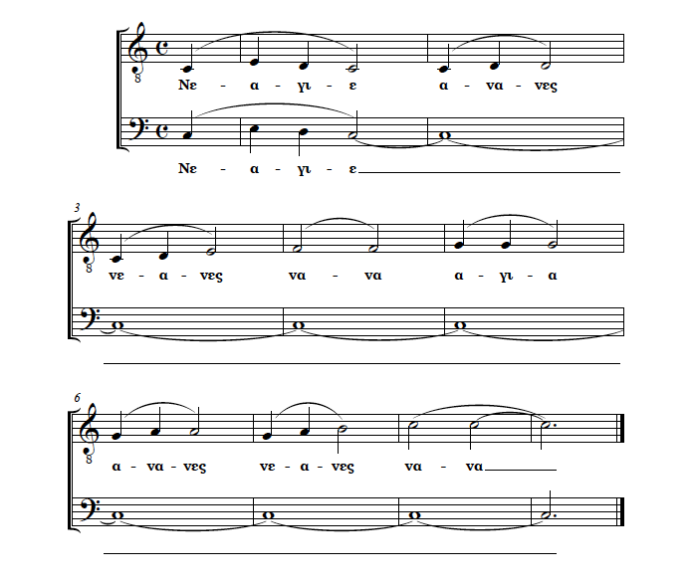
starting for example from the Main or Plagal Fourth mode, ascending or descending seven steps, he will find the same note as the note you chant (hypothetically) when you start chanting from the same modes at the same time.

Slide 22
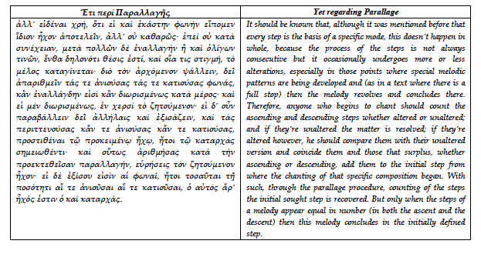

Slide 23
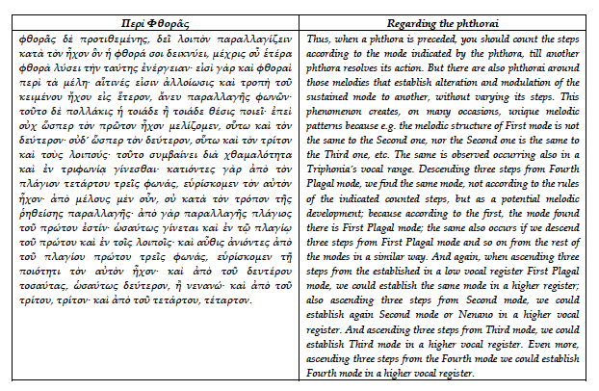

Slide 24
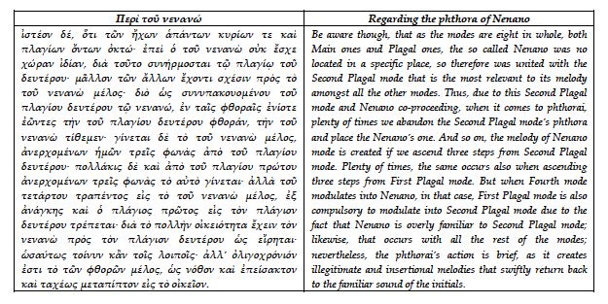

Slide 25
