Slide 1
Achilleas Chaldaeakes The Reflections of Ecclesiastical Policy in Sacred Music: the case of Patriarch Athanasios V
Associate Professor of Byzantine Musicology
at the Department of Musical Studies of the National and Kapodistrian University of Athens

Slide 2
The Patriarch of Constantinople Athanasios V is an exceptionally important Church figure, widely renowned to the relevant historical research. He was a Cretan; through historians he is described as “a wise man, whose outstanding prosperity was a scandal to the clergymen of the time; he would read European books and induce people towards education”; moreover he is reported as “an expert of Greek, Latin and Arabic dialects, being in parallel perfect as far as music is concerned”.

Slide 3
Μητροπολίτου Τουρνόβου κυρίου Ἀθανασίου, εἰς τὸν αὐθέντην Οὑγγροβλαχίας· ἦχος δ’ Πολυχρόνιον ποιῆσαι.
[codex Iviron No. 970 (Papadiki, written by monk Kosmas the so-called Macedon ), ff. 225^{r}-226^{v}]

Slide 4
«Ἀποβληθέντος καὶ γὰρ τοῦ προχρηματίσαντος πατριάρχου κὺρ Κυπριανοῦ, δι’ ἀγωγῆς κινηθείσης κατ’ αὐτοῦ ὑπὸ τῶν ἱερέων ἁπασῶν τῶν ἐκκλησιῶν, ἐφ’ οἷς ἠδικήθησαν, ἐπὶ τοῦ βασιλικοῦ βήματος, ἐνώπιον τοῦ ὑπερτάτου ἐπιτρόπου, οὗ τῇ προσταγῇ συμπαρέστημεν καὶ ἡμεῖς ἁπαξάπαντες οἱ συναδελφοὶ ἀρχιερεῖς, οἵτινες ἐρωτηθέντες ἐξείπομεν τὴν κατάστασιν ἐκείνου, ὡς ἡ ἀλήθεια ἔχει, κἀντεῦθεν καὶ ἀποβληθέντος, ὡς εἴρηται, ἐγένετο σκέψις κοινὴ καὶ συνοδικὴ εἰς ἐκλογὴν ἑτέρου προσώπου, τοῦ ἀναδέξασθαι τὴν προστασίαν τῆς ἀποστολικῆς οἰκουμενικῆς ταύτης καθέδρας, καὶ ἐξελέγη εἰς τοῦτο ὁ συναδελφὸς ἅγιος Κυζίκου κὺρ Κύριλλος· εἰθ’ οὕτω προσήλθομεν μετὰ τῆς αὐτοῦ ἱερότητος, προσκλήσει καὶ ἐπιταγῇ τῆς αὐθεντικῆς ἐξουσίας, ὁμοθυμαδὸν ἁπαξάπαντες, ἐπὶ τὸ φορέσαι δηλαδὴ τὴν αὐτοῦ ἱερότητα τὸ εἰθισμένον βασιλικὸν ἔνδυμα. Συμπαραστάντων δὲ πάντων ἐπὶ τοῦ βασιλικοῦ αὖθις βήματος, και τὸν ἐκλεγέντα ἀναγγειλάντων, ἐκεῖ ἠρωτήθημεν περὶ τούτου, περιβλεψάμενος καθ’ ἕνα ἕκαστον πάντας ἡμᾶς ὁ ὑπέρτατος ἐπίτροπος, κύκλῳ, προστάξει τῆς αὐτοῦ ὑψηλότητος, τὴν στάσιν εἰληφότας, ἀπεκρίνατο ἀποφηνάμενος ὅτι “ὑμεῖς μὲν τοῦτον”, τὸν προῤῥηθέντα δηλονότι, “ἐξελέξασθε, ἐγὼ δὲ οὐ συγκατανεύω· οὗτος καὶ γὰρ μετὰ καὶ ἄλλων ἐγγυησάμενος ὑπὲρ τοῦ Κυπριανοῦ, οὐκ ἦλθον δηλοποιῆσαί μοι ὡς οὐ καλῶς ἐκεῖνος πολιτεύεται. Τοίνυν (προσέφη) ἐγὼ ἢ τοῦτον (ἕνα ὄντα τῶν συναδελφῶν ἀρχιερέων), ἢ τοῦτον (τὴν ἐμὴν δηλονότι ἐλαχιστότητα) λέγω γενέσθαι πατριάρχην. Ἀλλὰ τοῦτον (ἐμὲ δηλονότι) ἐκ τῆς ὄψεως ἐγκρίνω”. Ἐμοῦ δὲ παραιτουμένου καὶ μὴ κατανεύοντος, παροτρυνόντων δὲ καὶ συναναγκαζόντων με τῶν συναδελφῶν ἀρχιερέων, ἡ περιβολὴ ἐπεγένετό μοι τοῦ βασιλικοῦ ἱματίου, ἑκόντι ἀεκοντί γε θυμῷ. Μετὰ δὲ ταῦτα ἐπηκολούθησεν ἐπ’ ἐκκλησίας καὶ ἡ νενομισμένη μετάθεσις μετὰ παῤῥησίας αὐτάρκους […] Ὁ ἔφορος τῶν ἁπάντων Θεός, ὁ κατὰ τὴν ἄῤῥητον αὐτοῦ πρόνοιαν καὶ ἄκραν ἀγαθότητα ἐπενεγκών μοι τὸ τηλικοῦτον θειότατον ἀξίωμα παρὰ προσδοκίαν καὶ πᾶσαν ἐλπίδα, γένοιτό μοι φύλαξ καὶ ὁδηγός…».

Slide 5
BIBLIOGRAPHY
Γεδεὼν Μ. Ἰ., «Ὁ Πατριάρχης Ἀθανάσιος Ε΄», Ἐπετηρὶς Ἑταιρείας Κρητικῶν Σπουδῶν 3 (1940), 193-205. Gerzmanus Eugenius, Manuscripta Graeca Musica Petropolitana. Catalogus, tomus I, Bibliotheca Publica Rossica, Petropolis 1996: “Glagol”, pp. 574-575. Idem, Manuscripta Graeca Musica Petropolitana. Catalogus, tomus II, Bibliotheca Rossicae Academiae Scientiarum. Archivus Academiae Scientiarum. Bibliotheca Universitatis. Hermitage, Petropolis 1999, p. 433. Εὐστρατιάδου Σωφρονίου, μητροπολίτου πρώην Λεοντοπόλεως, «Θρᾷκες μουσικοί», Ἐπετηρὶς Ἑταιρείας Βυζαντινῶν Σπουδῶν 12 (1936), 48-49, 66-67. Καραγκούνη Κωνσταντίνου Χαρ., Ἡ παράδοση καὶ ἑξήγηση τοῦ μέλους τῶν Χερουβικῶν τῆς βυζαντινῆς καὶ μεταβυζαντινῆς μελοποιίας, Athens 2003: Institute of Byzantine Musicology-Studies 7, pp. 382-386. Μανούσακα Μ. Ἰ., «Νέες εἰδήσεις γιὰ τὸν Κρητικὸ οἰκουμενικὸ πατριάρχη Ἀθανάσιο Ε΄ τὸ Μαργούνιο (1709-1711)», Τόμος εἰς μνήμην Γεωργίου Κουρμούλη, Athens 1988, pp. 451-468. Μπαλαγεώργου Δημητρίου Κ.-Κρητικοῦ Φλώρας Ν., Τὰ χειρόγραφα βυζαντινῆς μουσικῆς–Σινᾶ. Κατάλογος περιγραφικὸς τῶν χειρογράφων κωδίκων βυζαντινῆς μουσικῆς τῶν ἀποκειμένων στὴν βιβλιοθήκη τῆς ἱερᾶς μονῆς τοῦ ὄρους Σινᾶ, 1st volume, Athens 2008, pp. 294-295. Στάθη Πηνελόπης, Χρύσανθος Νοταρᾶς Πατριάρχης Ἱεροσολύμων. Πρόδρομος τοῦ Νεοελληνικοῦ Διαφωτισμοῦ, Athens 1999, p. 259. Χαλδαιάκη Ἀχιλλέως Γ., Ὁ πολυέλεος στὴν βυζαντινὴ καὶ μεταβυζαντινὴ μελοποιία, Athens 2003: Institute of Byzantine Musicology-Studies 5, pp. 452-453, 539-553. Idem, «Ἀθανάσιος Μαργούνιος, ὁ ἀπὸ Τορνόβου καὶ Ἀνδριανουπόλεως Πατριάρχης Κωνσταντινουπόλεως (ὁ Ε΄)», Μεγάλη Ὀρθόδοξη Χριστιανικὴ Ἐγκυκλοπαιδεία 1 (2010), 297-299. Χατζηγιακουμῆ Μανόλη Κ., Μουσικὰ χειρόγραφα Τουρκοκρατίας (1453-1832), 1st volume, Athens 1975, pp. 263-264. Idem, Χειρόγραφα ἐκκλησιαστικῆς μουσικῆς 1453-1820. Συμβολὴ στὴν ἔρευνα τοῦ νέου ἑλληνισμοῦ, Athens 1980: National Bank of Greece, pp. 40, 91 (notes 167-171), 148-149. Idem, Μνημεῖα Ἐκκλησιαστικῆς Μουσικῆς. Σῶμα δεύτερο. Καλοφωνικοὶ Εἱρμοὶ (17^{ος}-18^{ος}-19^{ος} αἰ.), 1st volume, Μέλη καὶ σχολιασμοί, Συνθέτες-Ἑρμηνευτές, Κατάλογοι-Εὑρετήρια, Athens 2007: Centre of Researches and Publications, pp. 63-65, 142-143.

Slide 6
I would, firstly, point out his reference to "alphabetic catalogue of those who flourished in this kind of music [i.e. Greek sacral music] at various times", a catalogue originally written by Kyrillos Marmarinos, Bishop of Tenos and afterwards copied by both Nikephoros Kantouniares from Chios and Chrysanthos from Madytos; there, he is described as “Athanasios Patriarch of Constantinople disciple of Balasios”.

Slide 7
Most specifically, Athanasios’ musical activity is mainly based upon his only recently found handwritten musical codex Sinai 1282 (a book contained John Kladas’ Akathistos Hymn melodies), a manuscript that is signed in f. 119^{r} with the following note: “the present Oikoi were written by me, Athanasios Margounios from Crete, Bishop of Tornovo, at the year 1687 of June 1st, while I was at the prison because of Patriarch Dionysios’ spitefulness”. The hardships that Athanasios suffered “due to Patriarch Dionysios’ spitefulness” become evident in this indirect way [we refer to Patriarch Dionysios IV, the so-called Mouselimis (+1696), who was elected Patriarch five times; he was chasing Athanasios, for reasons still unknown today, during his fourth Patriarchy (March of 1686–12th of October 1687)]; in addition, it is already noticed that “Athanasios’ oeuvre (like for instance, his well-known Kalophonic Heirmoi, especially if we take into consideration their text) owes its formation to the hardships he had suffered during his restriction to Mount Sinai”.

Slide 8
I waited patiently for the Lord; and he attended to me, and hearkened to my supplication.
And he brought me up out of a pit of misery, and from miry clay: and he set my feet on a rock, and ordered my goings aright.
Many bullocks have compassed me: fat bulls have beset me round.
They have opened their mouth against me, as a ravening and roaring lion.
Arise, O Lord, prevent them, and cast them down: deliver my soul from the ungodly: [draw] thy sword, because of the enemies of thine hand;

Slide 9
The turmoils of this life encircle me like unto bees about a honeycomb, O Virgin, and they have seized and now hold my heart captive, and I am pierced with the stings of afflictions, Maid; yet be, O all-holy one, my defender and helper and rescuer.
Times of sorrows, necessity, and trouble, and misfortunes in life have found me, O pure Maiden; and from all sides temptations have encircled me; but be my ally, and protect me in your almighty shelter.

Slide 10
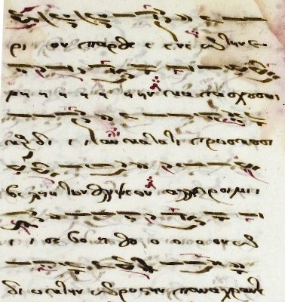
Codex No. 85/223 of K.A.Psachos’ Library (written by Apostolos Konstas from Chios in 1805), f. 86r-v

Slide 11
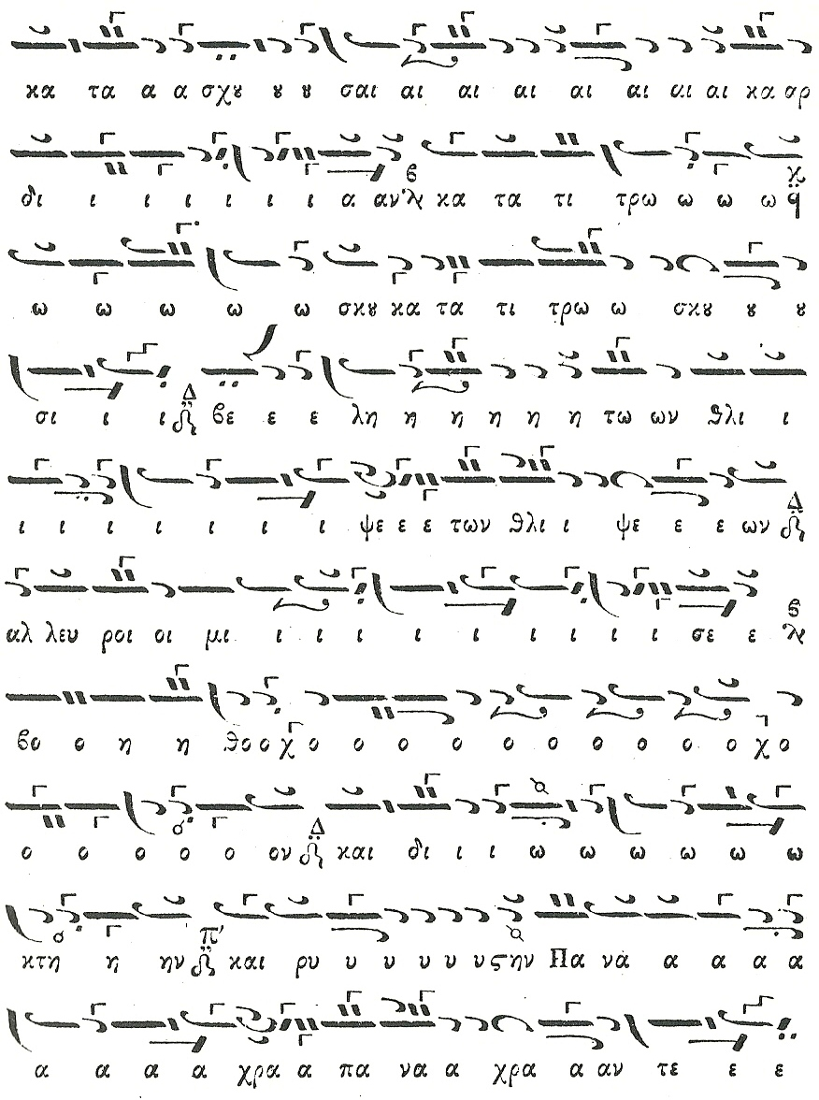
Kalophonic Heirmologion (Constantinople 1835), pp. 168-169

Slide 12
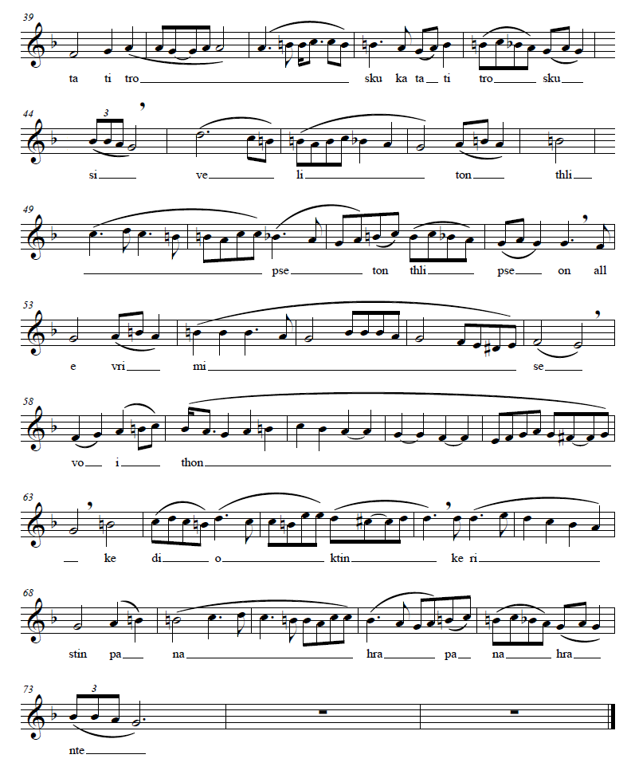

Slide 13
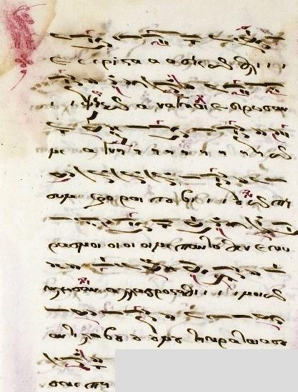
Codex No. 85/223 of K.A.Psachos’ Library (written by Apostolos Konstas from Chios in 1805), ff. 85v-86r

Slide 14
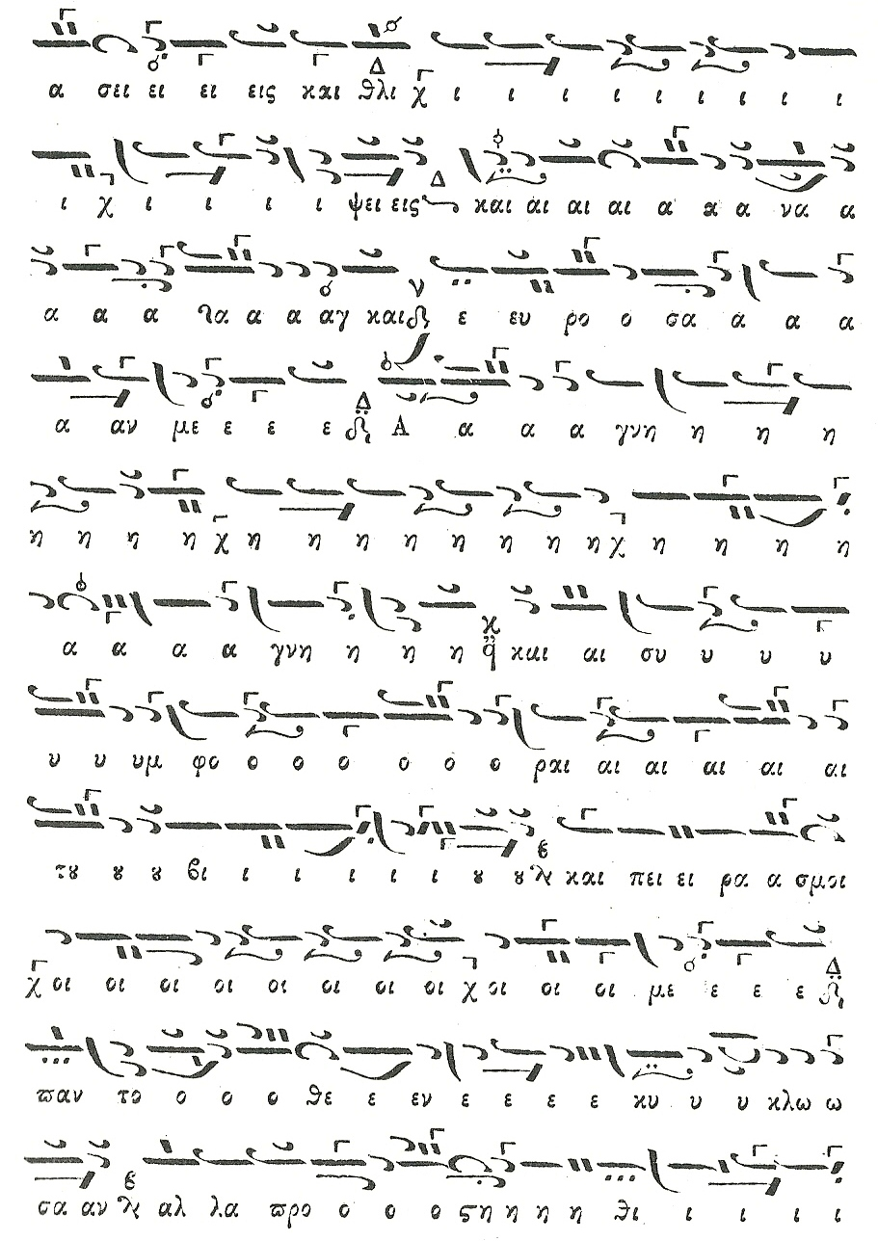
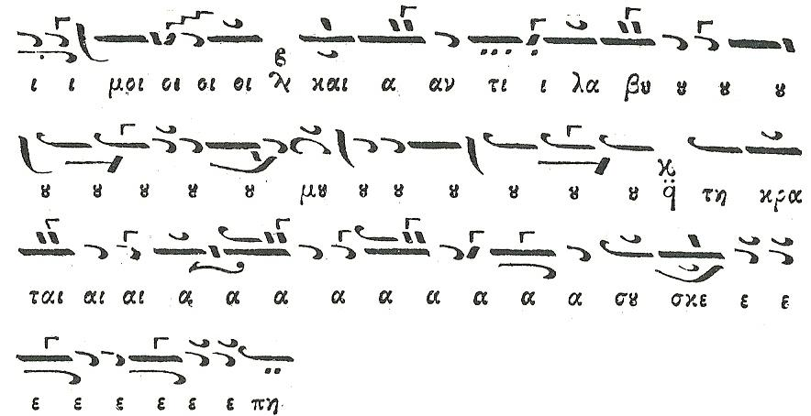
Kalophonic Heirmologion (Constantinople 1835), pp. 166-168

Slide 15
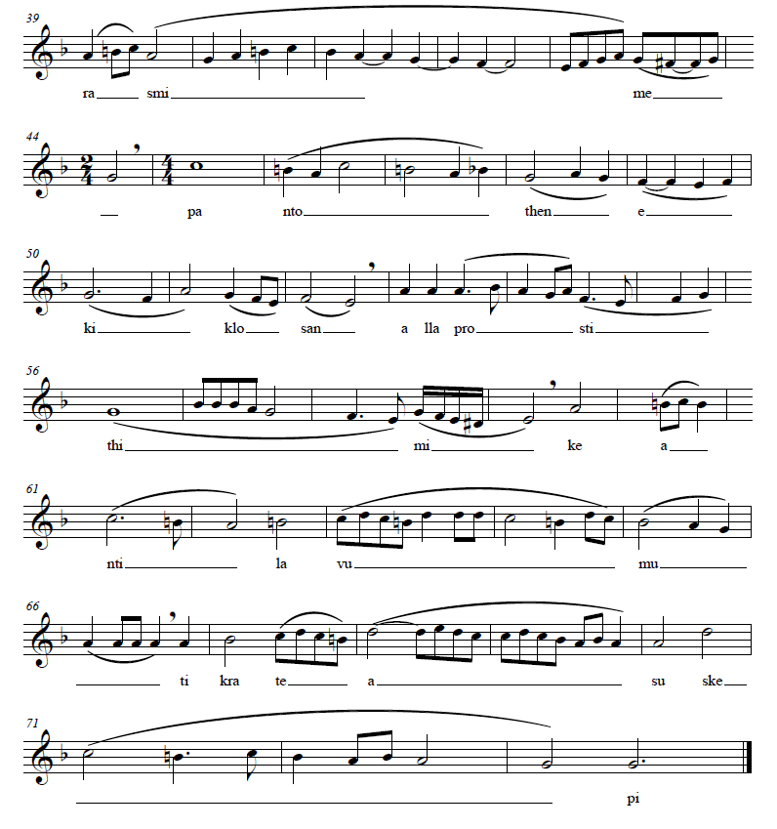

Slide 16
Times of sorrows, necessity, and trouble, and misfortunes in life have found me

Slide 17
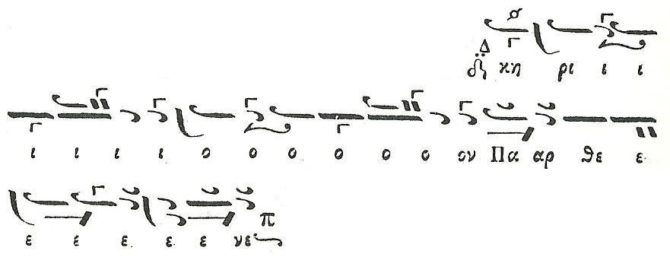
The turmoils of this life encircle me like unto bees about a honeycomb, O Virgin

Slide 18
The turmoils of this life encircle me like unto bees about a honeycomb, O Virgin

Slide 19
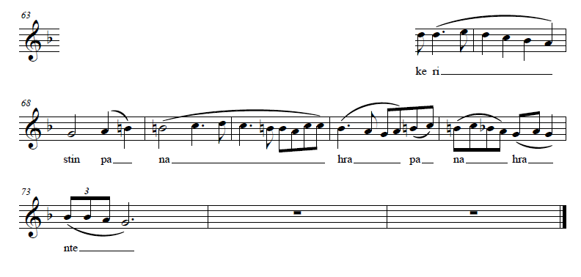
yet be, O all-holy one, my defender and helper and rescuer.

Slide 20
protect me in your almighty shelter

Slide 21
Taking into consideration both, the text on which those final cadences are based as well as Athanasios’ composing choice to end both of them on their fifth (a phenomenon undoubtedly creating a sense of “musical expectation”, which could drive us to a “philosophical anticipation” as well), I would observe that at this point lies a “hidden message”; our composer, Athanasios, a composer whose life was then full of sorrows, necessities, troubles, misfortunes, e.t.c. covered up a mystical prayer into his music, addressing to his all-holy one defender and helper and rescuer, a prayer that is nothing less than a – last but not least expressed – message of hope…

