Slide 1
Achilleas Chaldaeakes Associate Professor of Byzantine Musicology at the Music Department of the National and Kapodistrian University of Athens Byzantine Music “under cover”: exploring the true meaning of the so-called Parallage Axion Estin 2012 Conference (ΝΥ December 8th 2012)

Slide 2
“Parallage was to adapt the polysyllable notes on the neumes of the melody’s quantity, written, and to chant their continuous ascent and descent, and never the ison or large intervals”
Great Theory of Music by Chrysanthos of Madytos, translated by Katy Romanou, New York 2010 (The Axion Estin Foundation, New Rochelle), p. 242^{§70}

Slide 3
“Parallage is to apply the syllables of the notes on the neumes engraved, in such a way that when we see the neumes composed, to chant the notes; indeed, as much do the polysyllable notes diverge from the melos, that much do the monosyllable ones approach it; because when one learns to pronounce the musical work correctly in parallage, it suffices to change the syllables of the notes with the syllables of the words and he will be chanting it as melos”.
Great Theory of Music by Chrysanthos of Madytos, translated by Katy Romanou, New York 2010 (The Axion Estin Foundation, New Rochelle), p. 45^{§43}

Slide 4
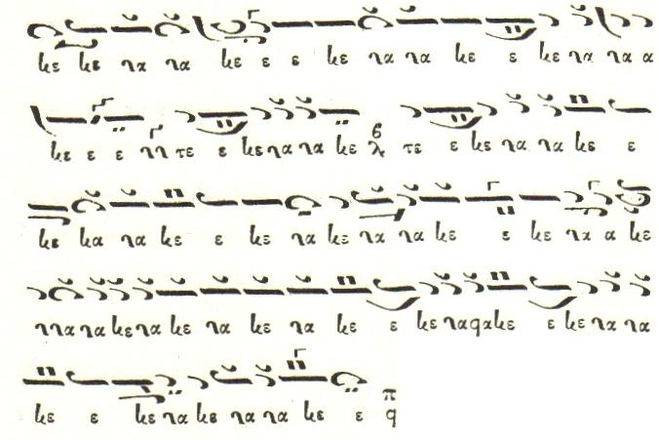

Slide 5
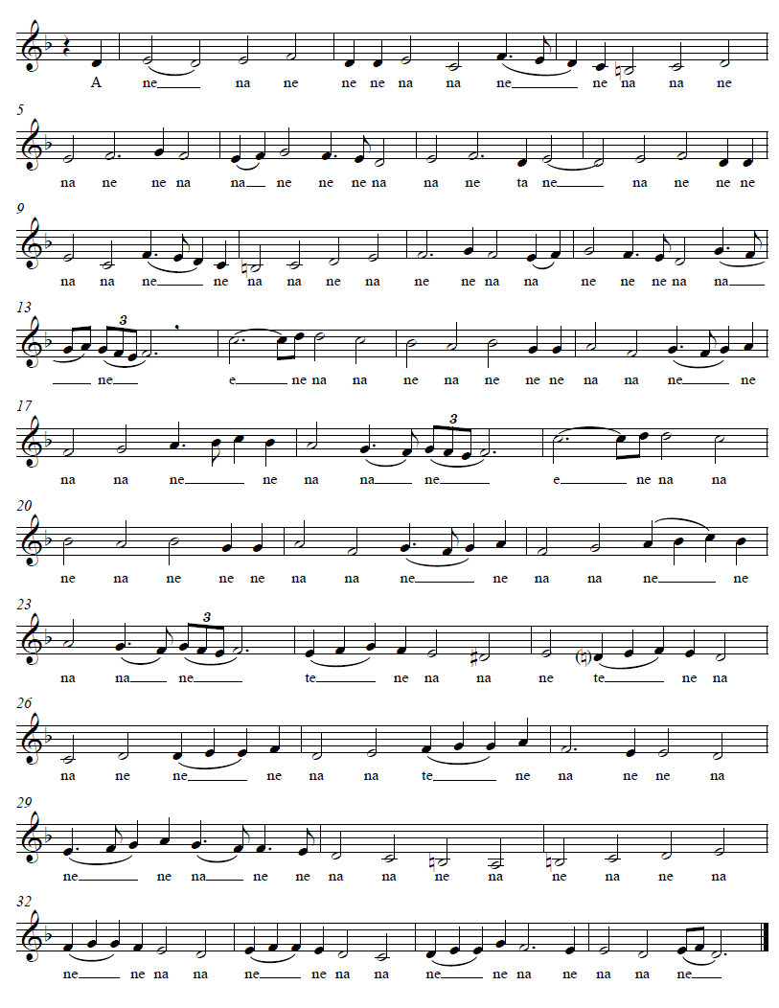

Slide 6
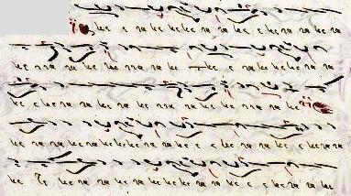
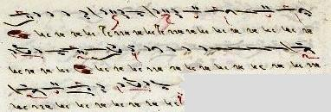

Slide 7
Parallage [that was to adapt the polysyllable notes on the neumes of the melody’s quantity, written, and to chant their continuous ascent and descent, and never the ison or large intervals], Metrophonia [that was to chant the melody of the troparion, as indicated by the neumes that notate the quantity of melody only, without observing the indications of the hypostaseis and the theseis] and Melos [that was to chant the melos of the troparion as indicated by the theseis of the neumes and the hypostaseis, by which is written not only the quantity of the melody but also the quality, without ignoring the words of the text];
Great Theory of Music by Chrysanthos of Madytos, translated by Katy Romanou, New York 2010 (The Axion Estin Foundation, New Rochelle), pp. 241-243^{§§69-73}.

Slide 25
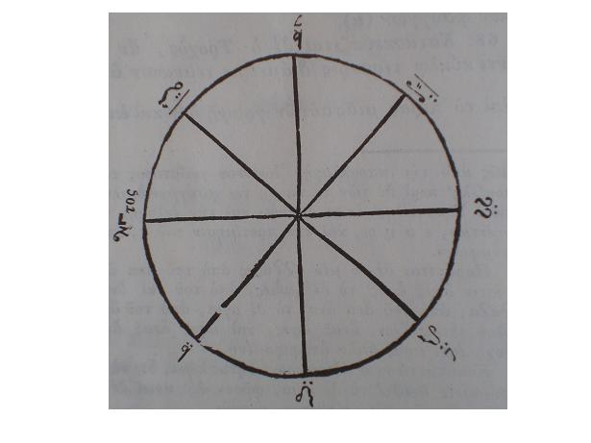

Slide 26
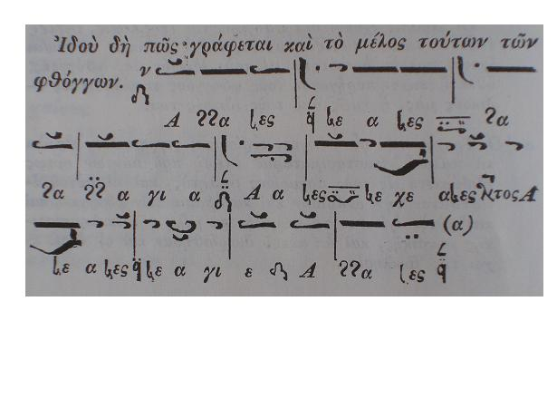

Slide 27
The ecclesiastical musicians call trochos a method, by which they ascend and descend diatonically the intervals of the pentachord, with the eight words, or polysyllables notes; in ascent: annanes, neanes, nana, agia; in descent: aanes, necheanes, aneanes, neagie. Those eight notes are called the notes of trochos.

Slide 28
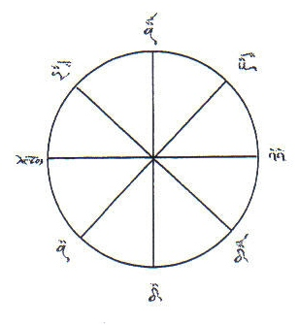

Slide 33
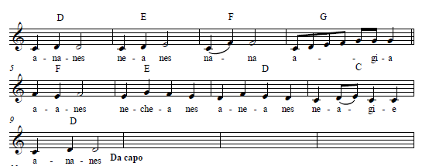

Slide 35
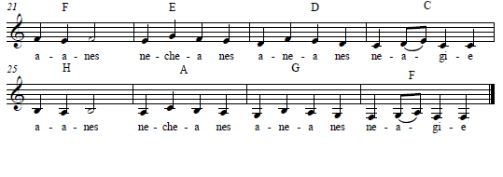

Slide 36
The trochos under discussion is illustrated in all the old Anastasimataria; because it was before everything else taught to beginners and they learned on it the ascent and the descent of notes and most mele of ecclesiastical music were composed on it, and the eight echoi of the church were organized on it.

Slide 37
The ecclesiastical musicians represented these four intervals, in ascent with the following four words annanes, neanes, nana, agia; in descent, with the following, which are similar, aanes, necheanes, aneanes, neagie. Those eight notes are called the notes of trochos.

Slide 38
The annanes derives from ἄνα ἄνες, that is ἄναξ ἄφες [king let]; the neane, from ναὶ ἄνες; the nana from ἄνα ἄνα; and the agia from ἅγιε [saint]; the entire, ἄναξ ἄφες, ναὶ ἄφες, ἄναξ ἄναξ, ἅγιε, being a wish addressed to God.

Slide 39
When we are going to sing –or to teach– we must begin with an Enechema. This term denotes the introduction of the Echos – annanes, for instance, which means “O Lord, forgive”. The reason (of this invocation) is that whatever begins ought to begin “from God” and to end, as well, “ in God”.

Slide 40
The Plagal Modes also have their di-phonic Modes in their ascent: Mode I Plagal has as its di-phonic Mode the Mode III; Mode II Plagal has Mode IV as its di-phonic Mode; Mode III plagal, i.e. Barys, has Mode I as its di-phonic Mode; and Mode IV Plagal has Mode II as its di-phonic Mode.

Slide 41
Mode I Plagal has as its di-phonic Mode the Mode III; Mode II Plagal has Mode IV as its di-phonic Mode; Mode III plagal, i.e. Barys, has Mode I as its di-phonic Mode; and Mode IV Plagal has Mode II as its di-phonic Mode.

Slide 42
Mode I Plagal has as its di-phonic Mode the Mode III; Mode II Plagal has Mode IV as its di-phonic Mode; Mode III plagal, i.e. Barys, has Mode I as its di-phonic Mode; and Mode IV Plagal has Mode II as its di-phonic Mode.

Slide 43
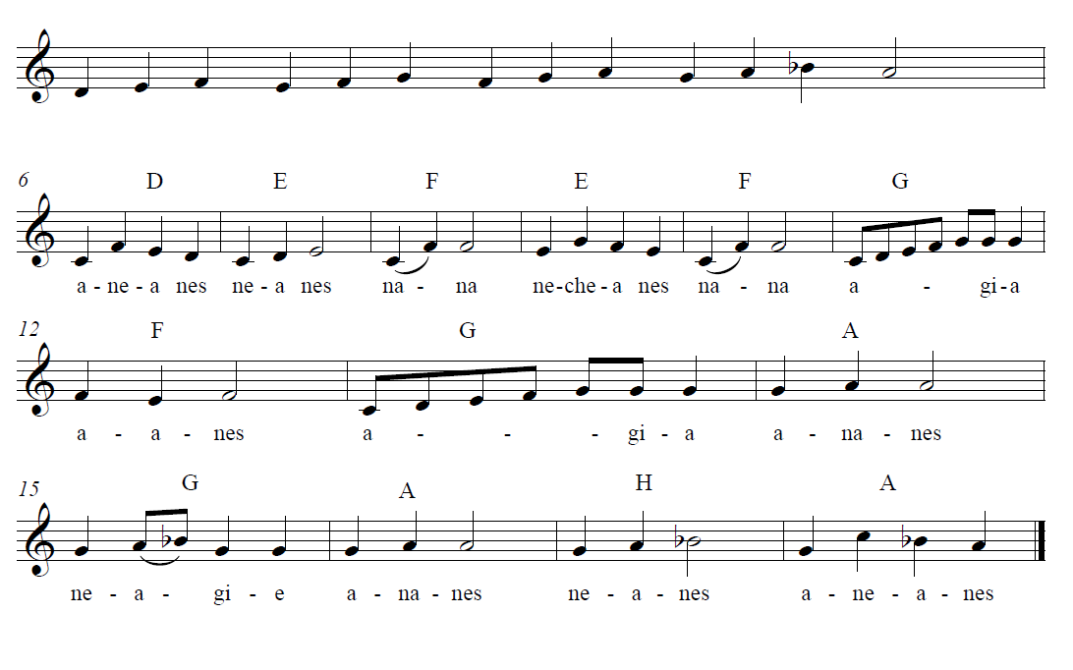

Slide 44
Know therefore, oh musician, how things are with the modes, either authentic or plagals, that is, if you move up three tones the same mode you find again, similarly with the plagals the same thing occurs. If you move down three tones from any of the plagals you again will find the same plagal mode.

Slide 45
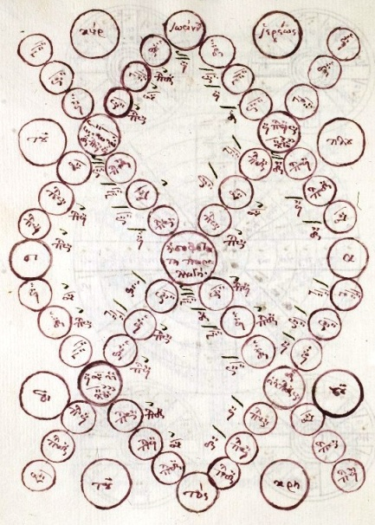

Slide 46
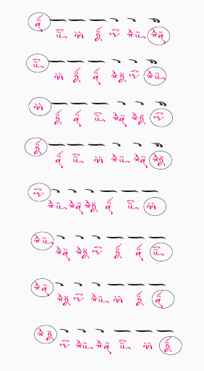

Slide 47
«Ἐνταῦθα βεβαιοῦται καὶ ὁ παλαιὸς ἐκεῖνος κανών, ὁ λέγων, πᾶσα τριφωνία τὸν αὐτὸν ἦχον ποιεῖ. ἔν τε ἀναβάσει καὶ αὖθις ἐν καταβάσει. οὐχ ὁμοίως δὲ ἐπὶ πᾶσι καὶ κατὰ πάντων, ἀλλὰ ποτὲ μὲν ἀπὸ μέλους, ποτὲ δὲ ἀπὸ παραλλαγῆς, καὶ ποτὲ μὲν οὕτως ποτὲ δὲ ἄλλως. καὶ ποτὲ μὲν ἀπὸ μέλους μόνον ποτὲ δ' ἀπὸ παραλλαγῆς καὶ μέλους ὁμοῦ, ποτὲ δὲ καὶ ἀπὸ παραλλαγῆς μόνης. Εὑρήσεις γὰρ ἐν τῷ οἴκῳ τοῦ πλαγίου τετάρτου, τὸν αὐτὸν καὶ τρίτον καὶ μέσον δεύτερον∙ ὥστε ἀπὸ μὲν τοῦ τρίτου τριφωνίαν ποιήσας, εὑρήσεις δεύτερον∙ ἀπὸ δὲ τοῦ μέσου δευτέρου, ἤγουν τοῦ νέανες, εὑρήσεις τρίτον τρεῖς φωνὰς ἀριθμήσας».

Slide 48
From the above quotation, note please, the following two passages: the one saying that specific canon [:“every triphonia creates the same mode”] happens “both in ascent and descent” and the concluding one, giving us the next example:
Three tones above III Mode is II Mode, while three tones below II Mode (‘neanes’) is III Plagal Mode.

Slide 49
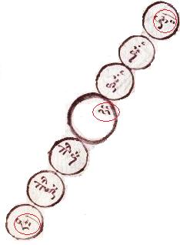

Slide 50
Three tones above III Mode is II Mode, while three tones below II Mode (‘neanes’) is III Plagal Mode.

Slide 51
Know this O listener, that the Mode is changeable; and that for this the Main Modes change [modulate] into the Plagal ones, and the Plagal into the Main ones again, just as the Master John Koukouzeles, of Blessed Memory, has shown in his wisest method of modulation. For he has demonstrated that in ascending by means of an Oligon, the Plagal Modes are [made] into main ones and that in descending be means of An Apostrophos the Main ones become Plagal.
Therefore known this, oh! Listener, that the modes have a tendency towards transformation and that is why the authentic transform into plagal and the plagal towards the authentic, as the blessed Maestor Ioannes Koukouzeles has shown in his most wise method and parallage, on the one hand by moving up with the oligon he showed the plagal modes as authentic and on the other hand moving down with the apostrophos he proved the opposite; the authentic modes as plagal.

Slide 52
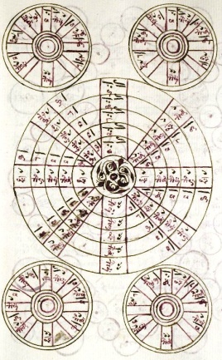

Slide 53
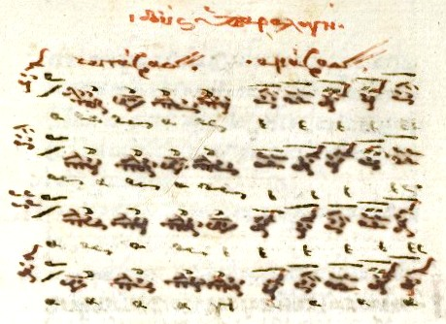

Slide 54
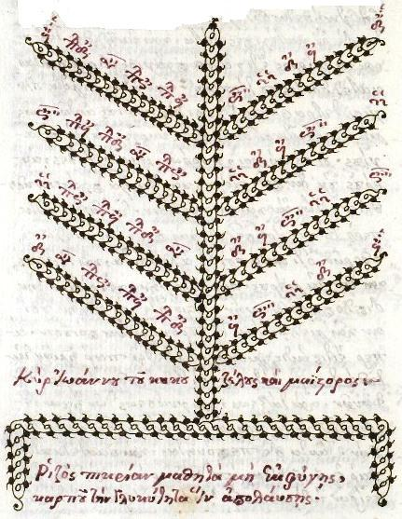

Slide 55
Once more I extract here, as a more specified example, the following passage of the above theoretical teaching of Plousiadenos:
«καὶ οὕτως, ὁ μὲν πλάγιος τοῦ τετάρτου γίνεται τέταρτος».
Same theoretical teaching is written in aforementioned anonymous treatise Interpretation of the Tones and Modes as follows:
If you move up from IV Plagal Mode four tones you shall find the IV Mode the tetraphonos; and this is its authentic.

Slide 56
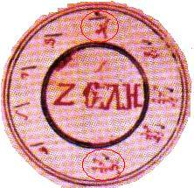

Slide 57
If you move up from IV Plagal Mode four tones you shall find the IV Mode the tetraphonos; and this is its authentic.

Slide 58
Which of those eight notes of the trochos has the priority? Which comes second, and is it expected to receive its onset from the first? Well, generally speaking, no one, because no one exists without an interval, which implies another note or tone; specifically though, all of them because every one of them may become first and second etc. depending on one’s needs.

Slide 59
“Their names –we read in Agiopolites– have already been written, both their proper names and those which indicate their order. As far as concerns the Echoi, however, it must be born in mind that we do not name the quantity of sounds, but the quality. For about sounds we normally use expressions like “shrillness”, “deepness”, “shortness”, “completeness”, and “clearness” – all of which denote the “such or such” sound, not the “so great” sound, or rather of what kind the sound is, not of what magnitude. Thus, the designations of the Echoi are not made for counting purposes but to represent the sound quality of the Melos”.

Slide 60
“The above, I suppose, must be enough to demonstrate the marvelous kinship of the Echoi. However, if somebody makes an even more accurate scrutiny of these matters, he will find thousands of features which prove the kinship. At present I have disregarded these, to avoid being criticized for loquacity. But those who are eager after knowledge may be guided by what I have written to find also the features which I have passed by, provided they really do engage themselves in this troublesome work”

Slide 61
